Slide 1


David Moreno
Mario Raushel
Terence Sin
Caleb Wells

Slide 2


Contents
Problem and Goal
Objectives
Design
Division of Labor
Analyze Design

Slide 3
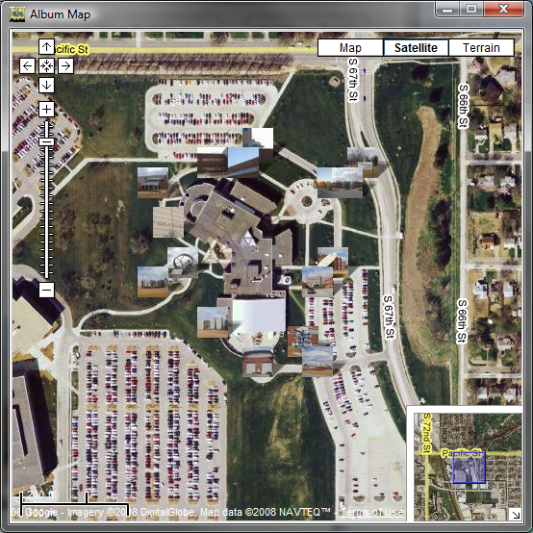
Problem Background
Create log/diary of your daily travels
Visualize diary through images categorized by date

Slide 4
Needs Statement
There is a need for users to autonomously create and explore daily photo life logs for both a fun and interesting experience.

Slide 5
Goal
The goal for this project is to create a wearable camera system capable of recording GPS data that will automatically record the daily life of the user based on a variety of triggers, and organize data.

Slide 6
Objectives
The prototype design should cost no more than $500
The prototype must be battery powered and capable of logging at least 4 hours without needing to be recharged
The camera unit should not cause any harm to the user
The camera should function well both indoors and outdoors

Slide 7
Objectives (part 2)
The GPS should function well in outdoor urban areas and have a decent failover for loss of signal indoors
The design must be comfortable to wear and lightweight
Accompanying software must be easy to use and understand

Slide 8
Design Constraints
Cost of the system (< $500)
Lightweight and comfortable (<1 lb)
Battery powered for at least 4 hours
Easy to access and replace charging system
One button SD card synchronization
User-friendly software
Usability both indoors and outdoors
Resilient to weather conditions

Slide 9
Proposed Design
Comprised of two main components – software application and camera system
Application used to configure settings for camera triggers
Use of SD card to transfer images taken and configuration file
Camera prototype logs images whenever a trigger occurs
Images uploaded to web album to be permanently stored
Map dynamically created for whichever album chosen.

Slide 10
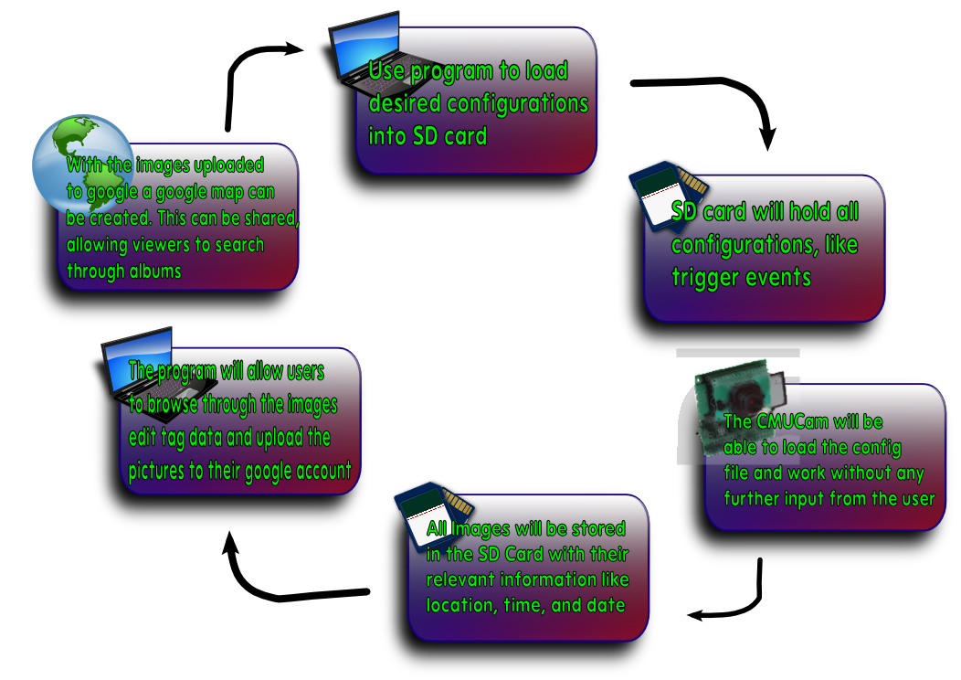
Proposed Design (Overview)

Slide 11
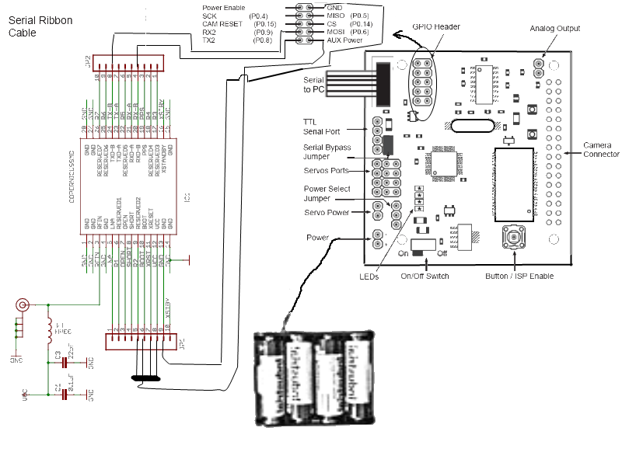
Proposed Design (Hardware)

Slide 12
Design Validation
Hardware
  Test the accuracy of the Copernicus GPS unit
  Test responsiveness of the camera
  Test quality of the pictures taken
  Test each trigger individually
Software
  Test the correctness of the data held by the SD card
  Test unusual data input that may occur
  Ensure files in the computer, SD card, or Google account are not accidentally deleted

Slide 13
Design Alternatives
Use of different GPS chips
Use Flickr for image hosting
Use of a different camera

Slide 14
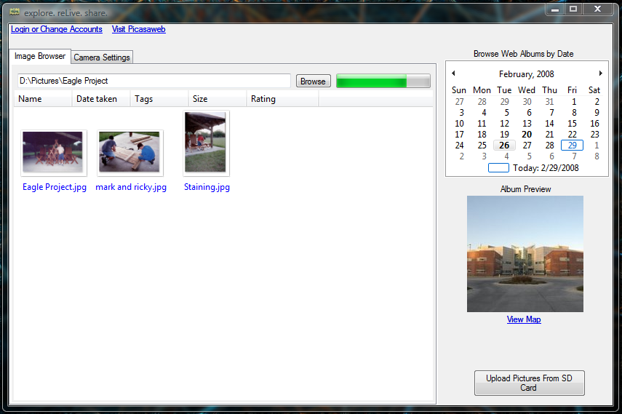
Preliminary Results

Slide 15
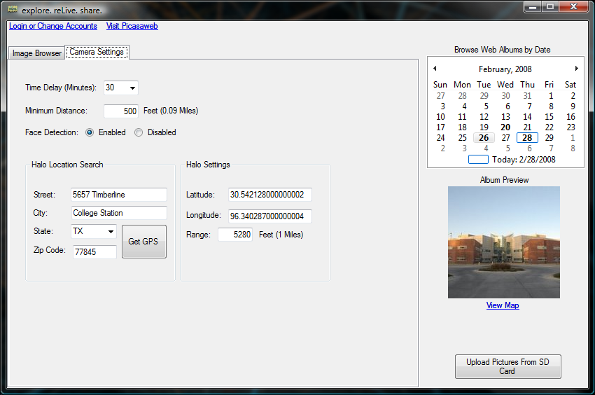
Preliminary Results (cont..)

Slide 16
Updated Budget
New Budget
  Single Unit
  Cmucam3 $ 239.00
  Trimble Copernicus GPS Chip $ 74.95
  Antenna $ 18.95
  SD Memory Card ~ $ 15.00
  Card Reader ~ $ 3.00
  Enclosure ~ $ 10.00
  3.3 Volt Regulator ~ $ 1.00
  Battery Pack ~ $ 5.00
  Batteries ~ $ 10.00
Total for 1 unit ~ $ 376.90

Slide 17
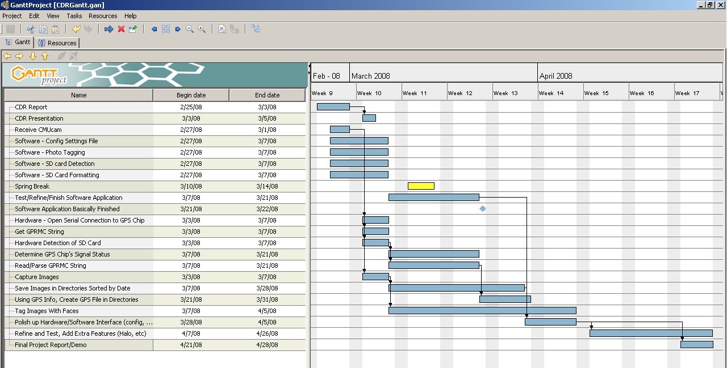
Updated Task Schedule

Slide 18
Project Management
David Moreno – In charge of hardware and CMUCam3 operations
Mario Raushel – In charge of software interface design
Terence Sin – In charge of image processing and software imaging functionality
Caleb Wells – Leader, In charge of GPS integration

Slide 19
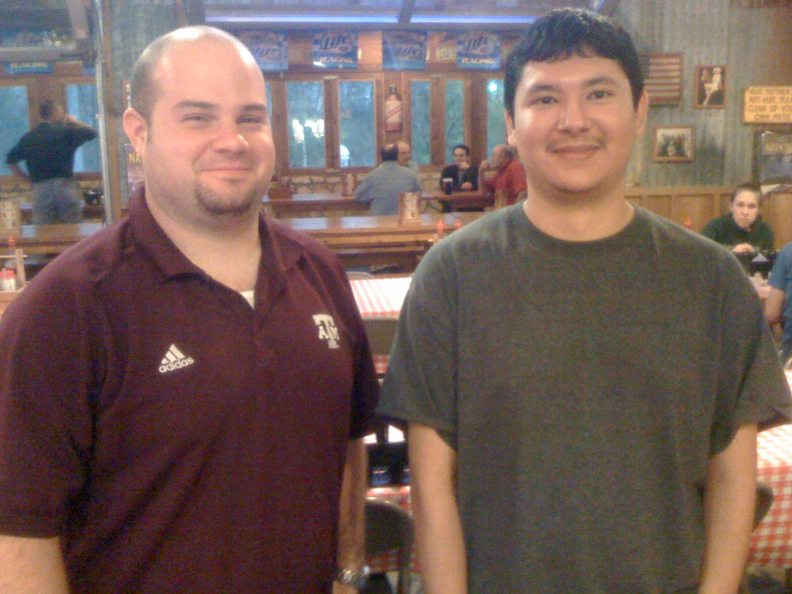
Effective Teaming
2-3 meetings each week to discuss updates and plans
Constant email communication providing individual progress reports
Team building activities such as meeting at Rudy’s for dinner

Slide 20
Societal, Safety, Political, and Environmental Analysis
Societal Analysis
  For privacy concerns the camera must be large enough that others can tell they are being photographed
Safety Analysis
  One of our key objectives is to create a camera unit that will not cause any harm to the user
Political Analysis
  Upon purchase user must agree it will not be used for malicious reasons. i.e. Spying
Environmental Analysis
  Will be supplied with rechargeable batteries.
  Lead free device.

Slide 21
Any Questions?

